Slide 1
NYC Motor Vehicles Accident Data
A comparative analysis of accident data based on NYC boroughs, time, seasons, number of vehicles, and the severity of accidents.
Data sourced from 2016 to 2021 NYPD/MVD accident reports resulting in over $1,000 of damage or losses.
Presented by:
Stephen Bennett
Joan Montilla
Ginger Francione

Slide 2
Ideal candidates for our analysis
While approaching this project we had two primary candidates in mind for the target audience:
Department of Transportation and the Motor Vehicles Department
Public Safety and Accident Prevention
Traffic Systems Inc
A private firm whose focus is on traffic light systems, pedestrian signals, and signage

Slide 3
What to expect in the following slides
Each team member will go through their 3 questions.
Each question will be stated, display the data/graphs used, and then provide a written/verbal summary of our findings.
Ending with our sources and citations used for the project.

Slide 4
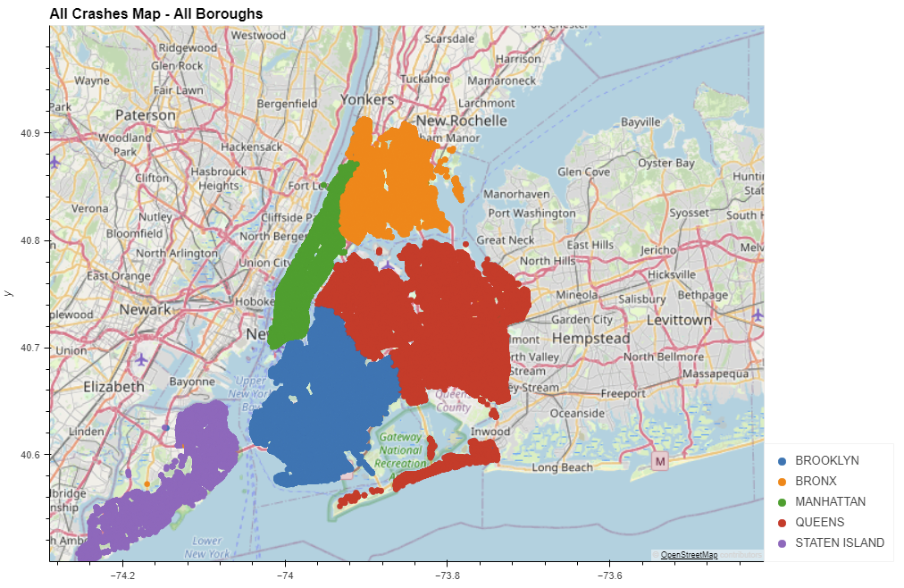
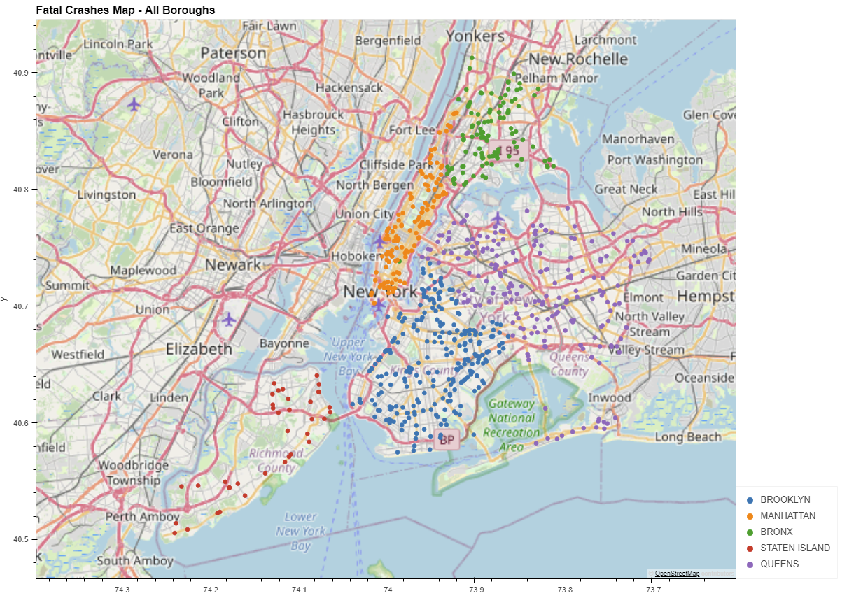
Can we use the data to map/visualize focus areas that are more likely to have accidents?
Did each borough or all of NYC have specific areas that are more likely to have major accidents?
STEVE
With over 640,00 points of data to map out all that we can really tell is NYC has a lot of accidents.
Filtering it down to only showing fatalities helps with visibility. However due to population differences one would expect Manhattan to have more than Staten Island for example.

Slide 5
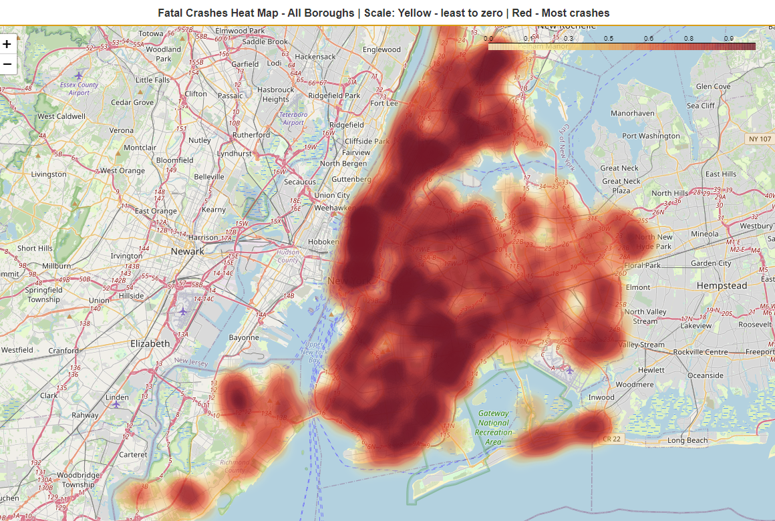
Can we use the data to map/visualize focus areas that are more likely to have accidents?
Did each borough or all of NYC have specific areas that are more likely to have major accidents?
STEVE
Next I narrowed down the data specifically by focusing on two things.
Fatality accidents only
Repeat occurrences of #1 visualized through a heat map using folium.
This way the darker the color red the more accidents that area had.

Slide 6
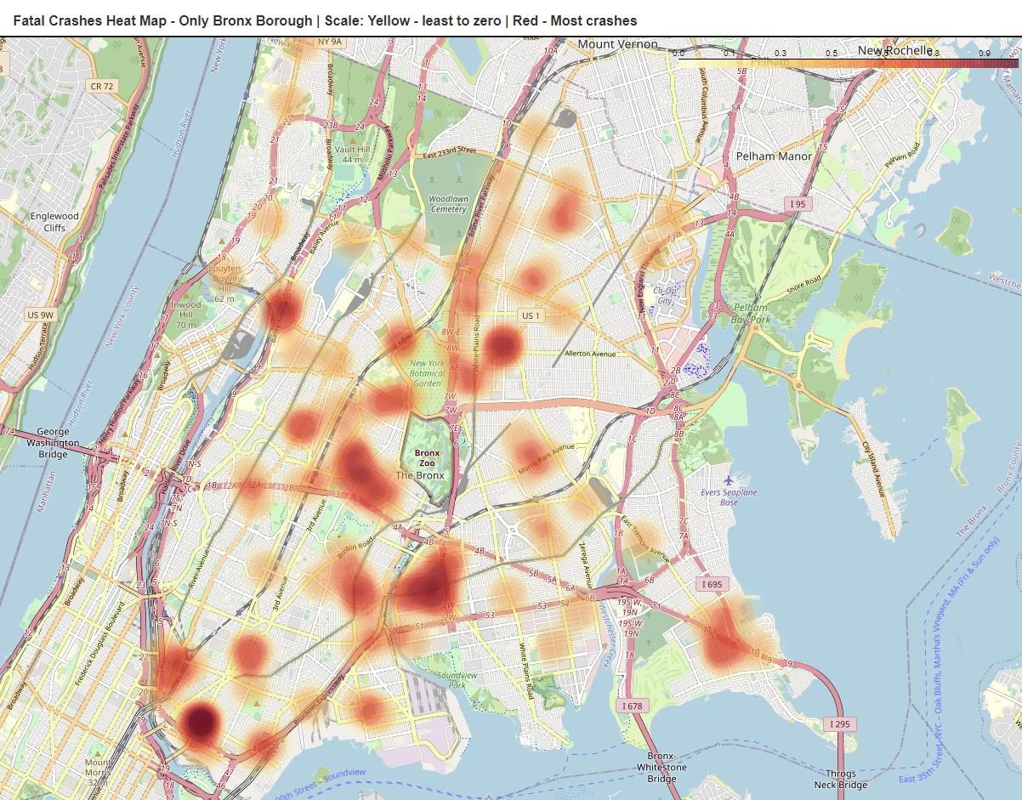
Can we use the data to map/visualize focus areas that are more likely to have accidents?
Did each borough or all of NYC have specific areas that are more likely to have major accidents?
STEVE
I also went into a macro zoom level for each borough individually.
This way if I was government agency or a private firm trying to find areas that need improvement or focus.
I can quickly pan around finding that result.

Slide 7
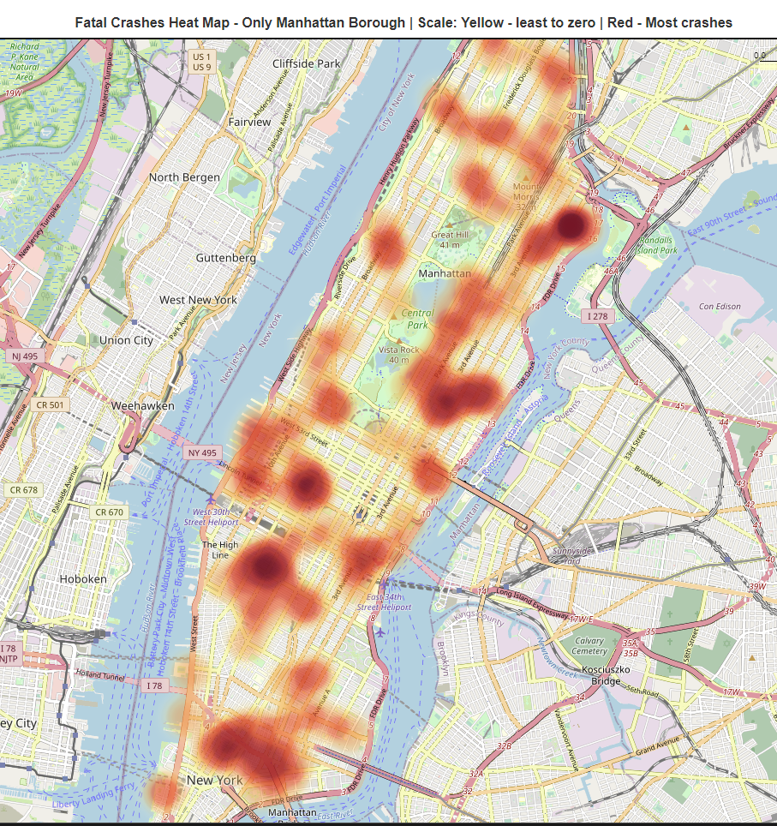
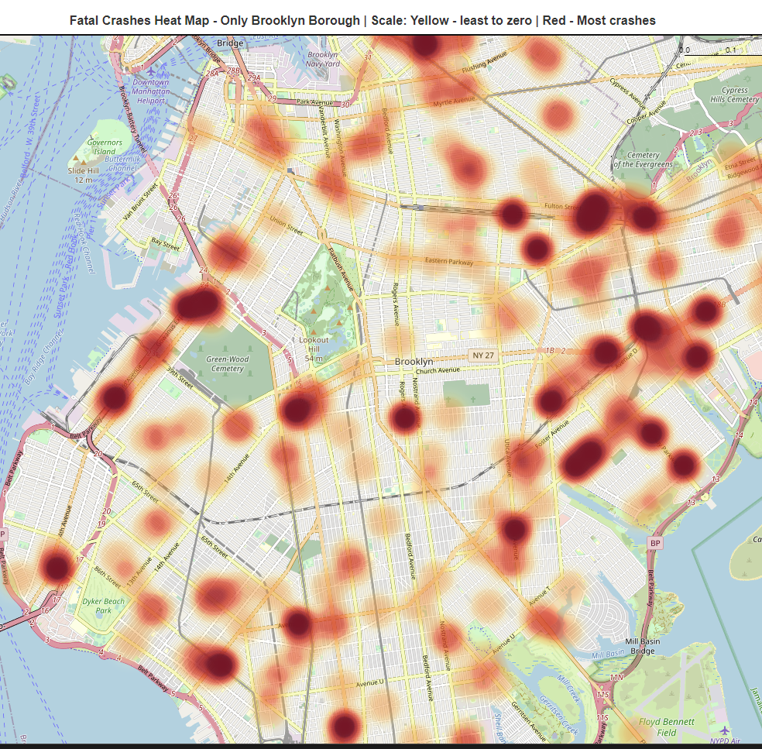
Can we use the data to map/visualize focus areas that are more likely to have accidents?
Did each borough or all of NYC have specific areas that are more likely to have major accidents?
STEVE

Slide 8
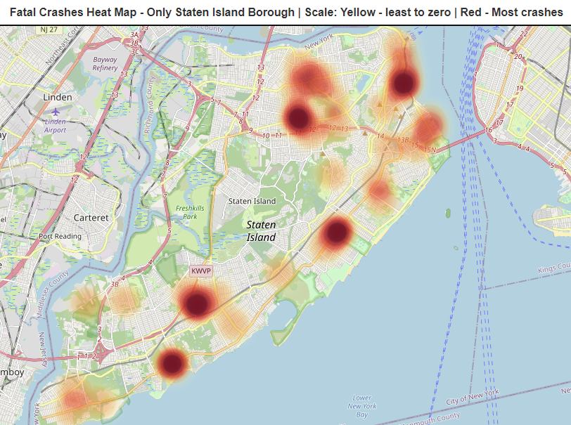
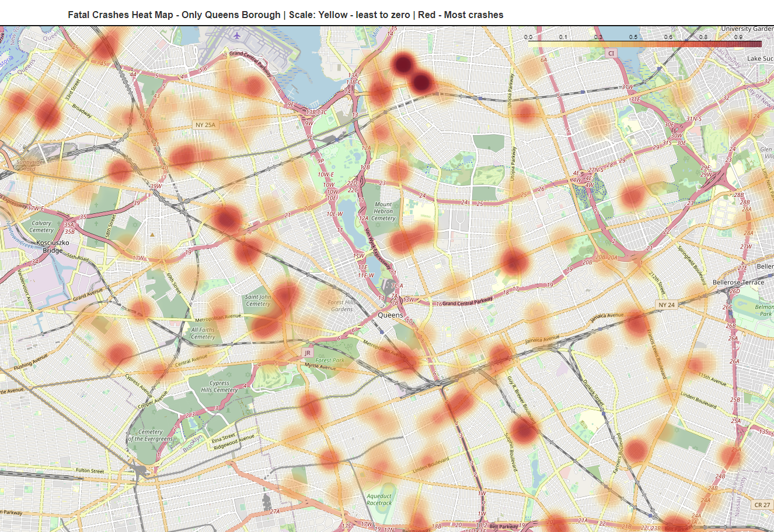
Can we use the data to map/visualize focus areas that are more likely to have accidents?
Did each borough or all of NYC have specific areas that are more likely to have major accidents?
STEVE

Slide 9
Can we use the data to map/visualize focus areas that are more likely to have accidents?
Did each borough or all of NYC have specific areas that are more likely to have major accidents?
STEVE
We discussed as a team that due to population variances it could be misleading to use a heatmap all 5 boroughs at once. This is why I broke down one for each borough individually so the heatmap only applied within its borders.
When you individually display each NYC Borough we saw that every borough had their own danger zones that are more likely to have major accidents.
This is indication that these areas may need further study for safety concerns by adding more police presence, speed cameras, adjust speed limits.
In addition we could verify if traffic signs are visible, functional, or check if they need to be added to troubled intersections.

Slide 10
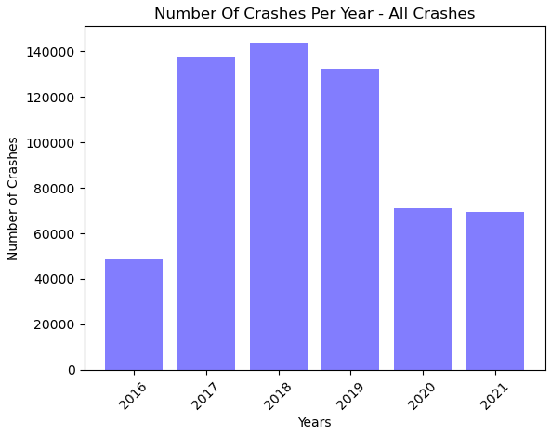
Has there been an increase in crashes over time?
Did COVID have any effect on the number of crashes?
STEVE
The introduction of COVID19 in January of 2020 definitely had a drastic impact on the number of accidents as you would expect.
More people were staying home, working from home, not travelling for leisure or pleasure.

Slide 11
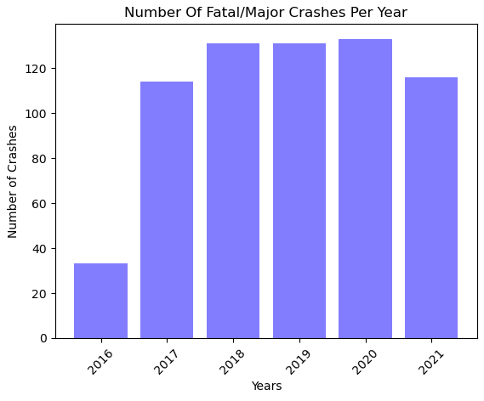
Has there been an increase in crashes over time?
Did COVID have any effect on the number of crashes?
STEVE
This was a very surprising result - there was an actual increase of major/fatal accidents in 2020 and then again in 2021 nearly matched 2017.
More people were staying home, working from home, not travelling for leisure or pleasure.
We had far less total accidents but nearly the same amount of major/fatal ones.

Slide 12
Has there been an increase in crashes over time?
Did COVID have any effect on the number of crashes?
STEVE
Further study into who was more likely driving during covid compared to pre-covid would be very interesting to see.
Are professional drivers / delivery / truckers a larger cause of major/fatal accidents?
Were people more reckless during covid?
This unfortunately created many more questions than answers with the limited set of data that we had.

Slide 13
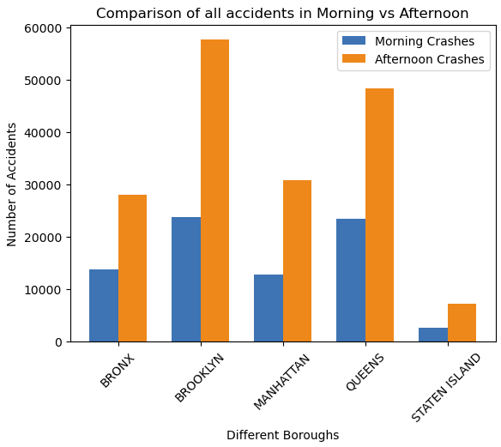
During normal work commute times - is there a difference in the number of crashes before or after a workday is completed?
STEVE
Data shows that there is a clear increase in accidents after the normal work shift has ended in all 5 boroughs.
At times nearly double or more the amount of accidents in the afternoon rush hour time periods.

Slide 14
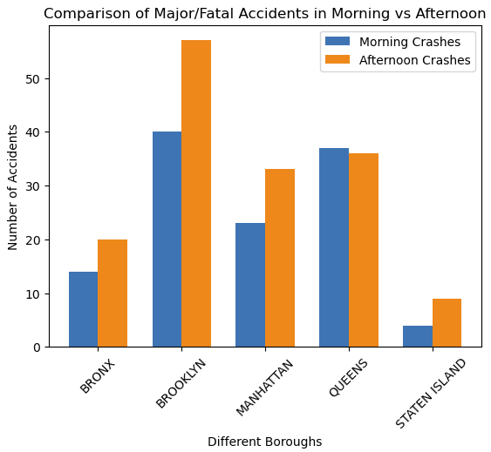
During normal work commute times - is there a difference in the number of crashes before or after a workday is completed?
STEVE
Data shows that there is a clear increase in major/fatal accidents after the normal work shift has ended in 4 of the 5 boroughs.
It is interesting to see Queens Borough break the pattern from the other 4.

Slide 15
During normal work commute times - is there a difference in the number of crashes before or after a workday is completed?
STEVE
The bar charts showed a clear difference of morning commute time crashes vs afternoon commute times in 4 of the 5 boroughs. (On average afternoon had substantially more accidents)
Further study would be needed regarding why Queens broke the norm of the other 4 boroughs.
Possible Solution:
Public awareness about possible road rage post work shifts.
Incentivize businesses to start and end shifts outside of the normal business day to reduce traffic bottlenecks.
Increased police, verify signage, lower speed limits during high traffic times.

Slide 16
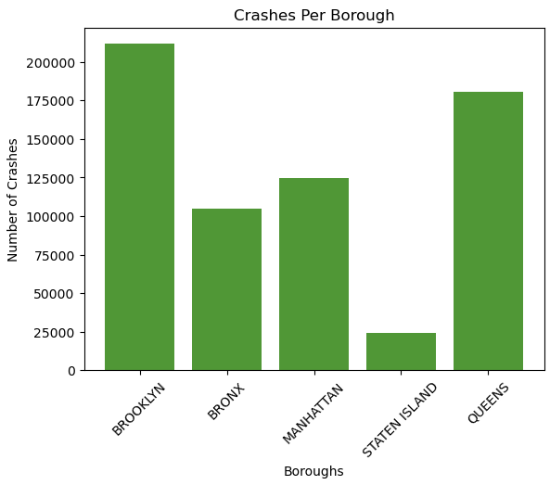
Are specific NYC Boroughs more likely to have accidents than others? (Including checking for population normalization)
JOAN
The graphs shows that Brooklyn and Queens are more likely to have accidents than the other 3 boroughs

Slide 17
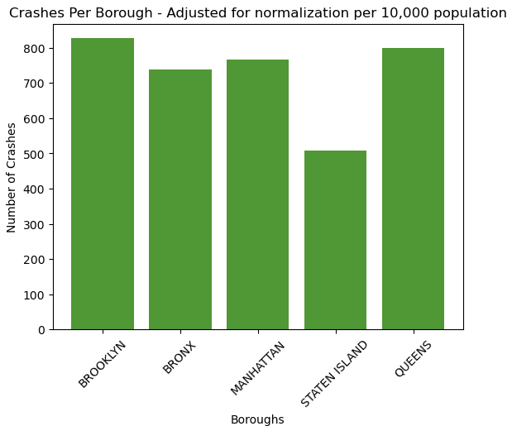
Are specific NYC Boroughs more likely to have accidents than others? (Including checking for population normalization)
JOAN
If we normalize the data based on crashes per 10,000 population we still see Brooklyn and Queens as #1 and #2.
However it does make the difference less severe than it first appeared.

Slide 18
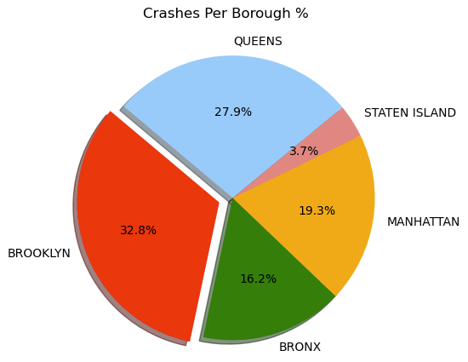
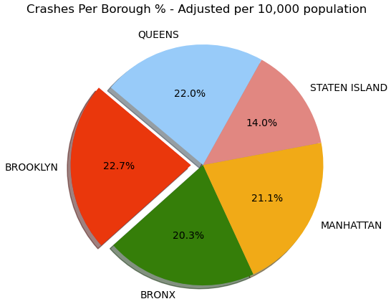
Are specific NYC Boroughs more likely to have accidents than others? (Including checking for population normalization)
JOAN
Alternative view through a pie chart:
Percentage wise Brooklyn is the most likely borough to have accidents in NYC.
Normalizing the data based on population the results become more evenly distributed - Brooklyn is still the highest by a very slight margin.

Slide 19
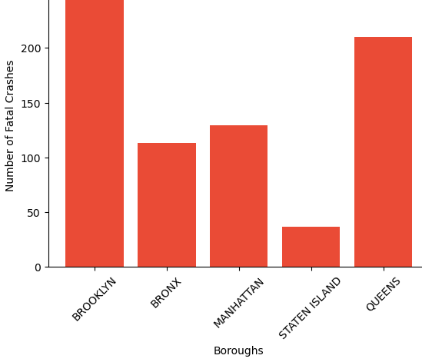
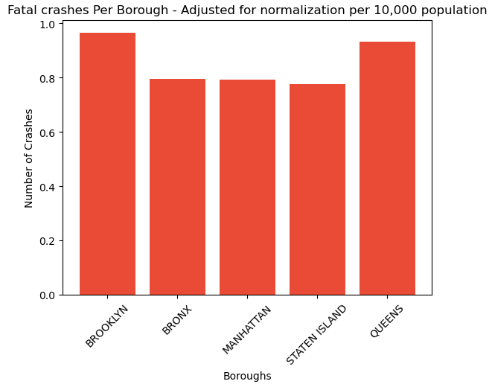
Are specific NYC Boroughs more likely to have accidents than others? (Including checking for population normalization)
JOAN
Results for major/fatal crashes were the same as all crash data. Brooklyn & Queens at first appearing to be far ahead but only slightly when adjusting for population.

Slide 20
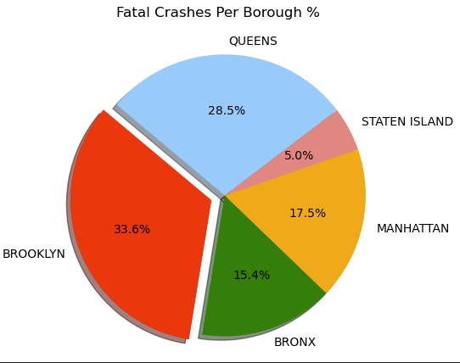
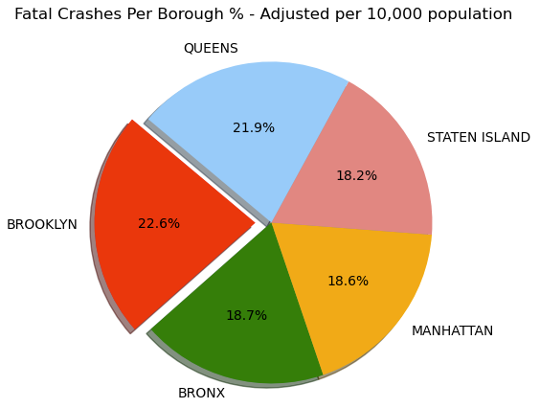
Are specific NYC Boroughs more likely to have accidents than others? (Including checking for population normalization)
JOAN
Results for major/fatal crashes were the same as all crash data. Brooklyn & Queens at first appearing to be far ahead but only slightly when adjusting for population.

Slide 21
Are specific NYC Boroughs more likely to have accidents than others? (Including checking for population normalization)
JOAN
When comparing graphs and pie charts from all crash data vs fatal crash data - we found the results to be equivalent visually to each other.
Possible Solution:
Consider adding some or more speed bumps in the higher risk boroughs.
Increased police, verify signage, lower speed limits during high traffic times.

Slide 22
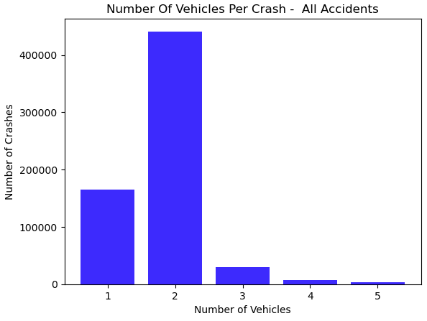
Is there a noticeable trend with how many vehicles are involved in a crash?
Compare if accidents had multiple vehicles more often than your normal 2 car accident.
JOAN
As one would suspect - most accidents typically will involve two vehicles.
This confirms that by a large margin.

Slide 23
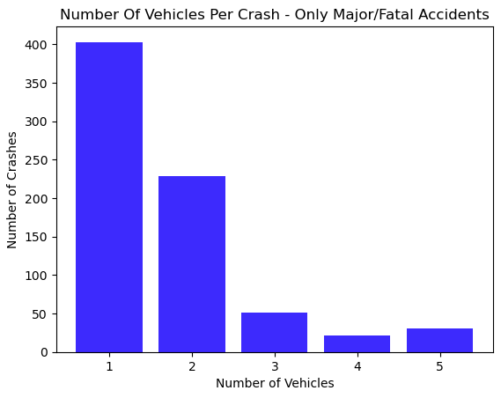
Is there a noticeable trend with how many vehicles are involved in a crash?
Compare if accidents had multiple vehicles more often than your normal 2 car accident.
JOAN
When viewing only major/fatal accidents we have a huge swing towards single car involvement.
This could indicate that pedestrian related accidents with single vehicles are the leading cause of major/fatal accidents in NYC.
Drunk drivers could also be a factor smashing into poles, buildings, and unfortunately people.

Slide 24
Is there a noticeable trend with how many vehicles are involved in a crash?
Compare if accidents had multiple vehicles more often than your normal 2 car accident.
JOAN
Possible solution
City marketing campaigns to increase awareness when driving to reduce speeds and keep eyes on the road.
City marketing campaigns to increase awareness when driving to pay attention to cyclist, scooters, and pedestrians.
Drunk driving may have a critical role in this visualization. Unfortunately in the data provided cannot be sure and it will need further research.
Verify crosswalks are clearly marked / walk & stop signs are functioning to help reduce single vehicle accidents. (Presumably with pedestrians)
Focus on reducing speed and possible road-rage to help reduce risk of accidents.

Slide 25
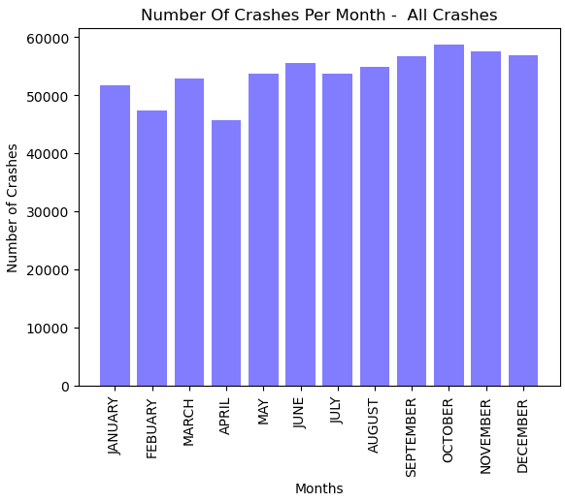
Determine if accidents are more likely during certain months.
JOAN
The data displayed evenly across each of the months with a small exception of maybe February or April.

Slide 26
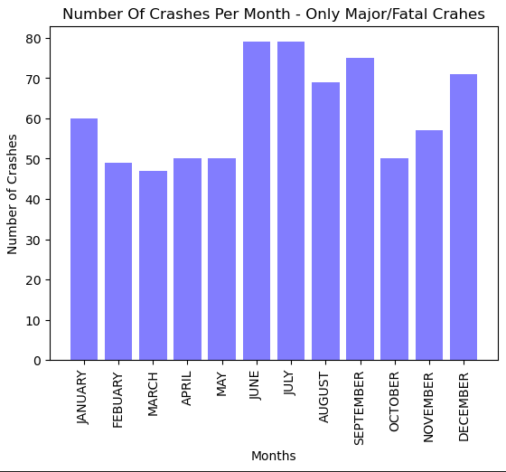
Determine if accidents are more likely during certain months.
JOAN
The data displayed quite differently compared to the all-crashes graph.
Here we can see a spike during winter and then again during summer.

Slide 27
Determine if accidents are more likely during certain months.
JOAN
Possible solution:
During nicer weather months consider reducing speeds and more public awareness since vehicles are likely moving faster.
During the December and January months the city could work on de-icing methods, clearing roadways, and public education about speed/winter habits.
Review needs for road repairs that could be causing accidents.
Increased police, verify signage, lower speed limits during high traffic times.

Slide 28
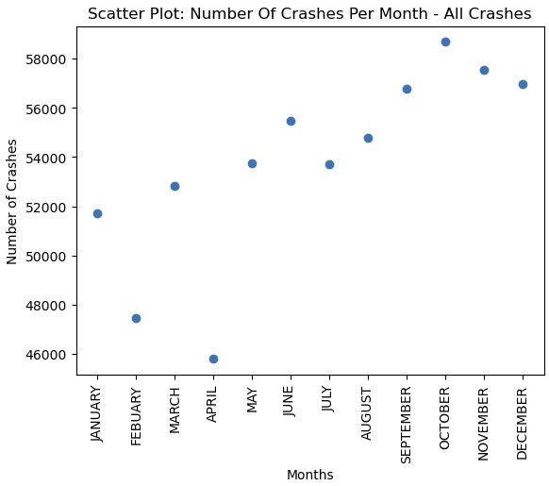
Can we better visualize the number of crashes based on the time of day, month, or number of vehicles through scatter plots.
GINGER
The data displayed evenly across each of the months with a small exception of maybe February or April
When displayed as a scatter plot it provides a more simple view detailing the difference of each month.
Using time series forecasting we concluded in this 5 year window of data that future accidents will also peak during September through December

Slide 29
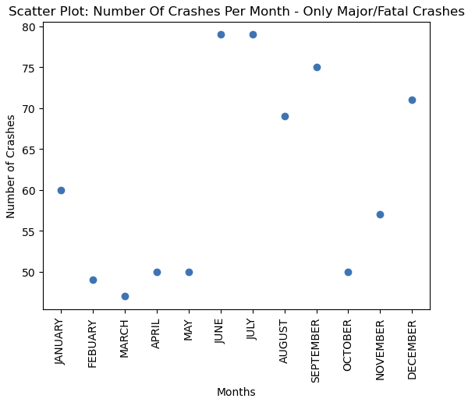
Can we better visualize the number of crashes based on the time of day, month, or number of vehicles through scatter plots.
GINGER
The data displayed quite differently compared to the all-crashes graph. Here we can see a spike during winter and then again during summer.
However there is less of a noticeable upward trend. The data is bit more erratic up and down across the months.
Using time series forecasting we concluded in this 5 year window of data that future major/fatal accidents will spike starting around June (summer) and then spike again in December (winter).

Slide 30
Can we better visualize the number of crashes based on the time of day, month, or number of vehicles through scatter plots.
GINGER
Possible solution
During nicer weather months consider reducing speeds and more public awareness since vehicles are likely moving faster.
Same can be said during winter time when roadways could be slippery or have hazards.
Could also indicate the need for road repairs that could be causing accidents.

Slide 31
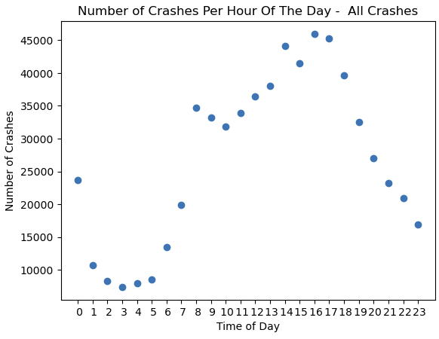
Can we use the time of day as a prediction method for future crashes?
GINGER
The scatter plot shows a trend that as the workday ends the number of accidents goes up around 2 pm peaking around 4 to 5 pm then declines as the night ends.
There is also a clear spike in accidents when the morning commute begins.
This confirms our previous findings when looking at commute times.
Using time series forecasting we concluded in this 5 year window of data that future accidents will also peak starting in the morning around 7 am reaching a maximum at 3 pm.

Slide 32
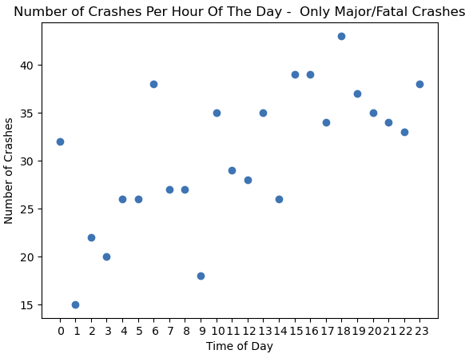
Can we use the time of day as a prediction method for future crashes?
GINGER
When only viewing major/fatal accidents the correlation of time vs event becomes quite a bit less predictable.
There is still a slight upward trend as the day goes on the number of incidents occur and a slight taper at the end of the day.
However it is not nearly as clear cut as before.

Slide 33
Can we use the time of day as a prediction method for future crashes?
GINGER
Scatter plots definitely helped confirm our previous findings and helped solidify our thoughts / questions.
They provided clear visualizations over bar or line charts in the majority of the uses.
Possible solution
Public awareness about possible road rage post work shifts when you're more likely tired.
Incentivize businesses to start and end shifts outside of the normal business day to reduce traffic bottlenecks.
Focus on reducing speed and possible road-rage to help reduce risk of accidents.
Increased police, verify signage, lower speed limits during high traffic times.

Slide 34
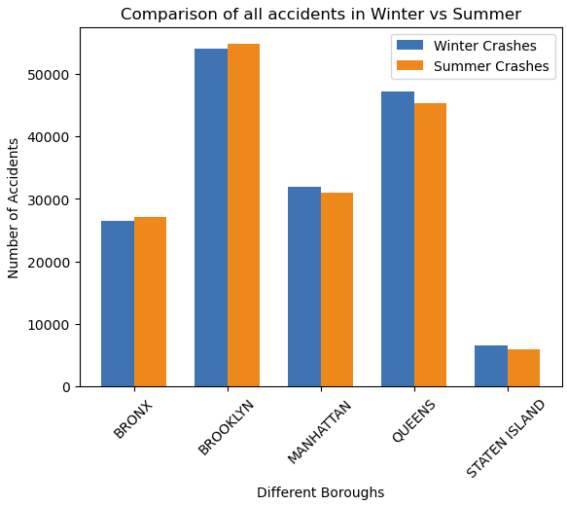
Did winter or summer have any effect on the number of accidents?
GINGER
When viewing the entire set of data it looks like they are all very close going back and forth between boroughs.
There is no clear pattern if winter or summer is more predominant.

Slide 35
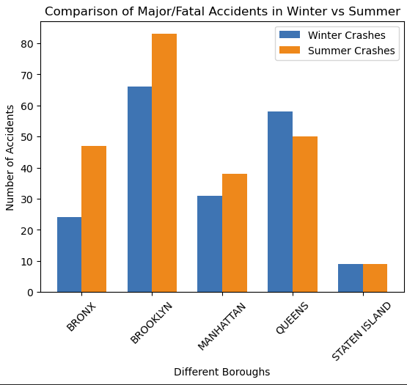
Did winter or summer have any effect on the number of accidents?
GINGER
When we only view major/fatal accidents there is a much different result.
Bronx , Brooklyn, Manhattan show to have substantially more accidents in the summer than Queens and Staten Island.
Queens shows the inverse - they have more accidents in the winter.
Staten Island shows no difference in seasons.

Slide 36
Did winter or summer have any effect on the number of accidents?
GINGER
Possible solution:
Since there is a noticeable increase during the summer months we could look at more public awareness during heavier traffic times.
Focus on reducing speed and possible road-rage to help reduce risk of accidents during summer months.
Increased police, verify signage, lower speed limits during high traffic times of the year.

Slide 37
Sources / Citations
- Motor Vehicle Collisions - Crashes -
https://catalog.data.gov/dataset/motor-vehicle-collisions-crashes
- The Motor Vehicle Collisions crash table contains details on the crash event. Each row represents a crash event. The Motor Vehicle Collisions data tables contain information from all police reported motor vehicle collisions in NYC. The police report (MV104-AN) is required to be filled out for collisions where someone is injured or killed, or where there is at least $1000 worth of damage
- US Census 2021 Data
https://www.census.gov/data/developers/data-sets.html#:~:text=The%20Census%20Bureau's%20Application%20Programming,users%20to%20create%20custom%20queries
https://www.census.gov/data/developers/data-sets/popest-popproj/popest.html
https://api.census.gov/data/2021/pep/population/variables.html

Slide 38
Sources / Citations Continued Page 2
https://portal.311.nyc.gov/article/?kanumber=KA-02877
List of all counties and their respective Borough name need to convert official county name into the commonly known names
https://python-visualization.github.io/branca/colormap.html#branca.colormap.LinearColormap
https://www.kaggle.com/code/daveianhickey/how-to-folium-for-maps-heatmaps-time-data

Slide 39
Additional files / Generated items
**#Additional files generated / used:**
- Main data set from data.gov
- git\group_project_1\data\nyc_mv_crash_data_truncated4.csv
- Generated data:
- git\group_project_1\heatmaps\*.html
- Multiple generated heatmaps for all of NYC and each borough
- all_crashes.html - Point HVPLOT of all crashes in NYC
- fatal_crashes.html - Point HVPLOT of all fatal crashes in NYC

Slide 40
Questions / End of presentation
Any questions?

